Slide 1
IEEE@UNM General Meeting
4/18/2023

Slide 2
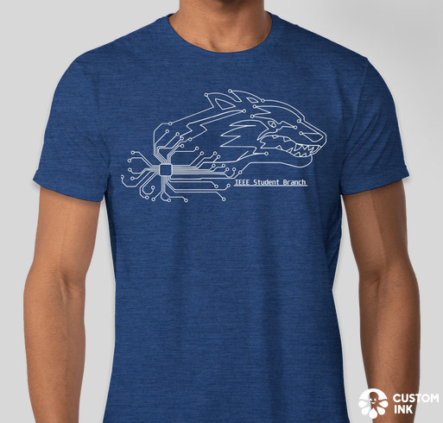
T-Shirts!
Period to order closes tomorrow, April 19th!!
Use this link to place an order: https://www.customink.com/g/ezb0-00cq-yp2u
Please take note of the two shipping options available:
“Ship to My Address” – you may pay a fee to have it delivered to your house.
“Ship to Gabriel” – You can come pick up your t-shirt at our last IEEE meeting of the semester, Tuesday, May 2 at 6:30pm.

Slide 3
General Officer Requirements
Expected to attend bi-weekly officer meetings and chapter events.
Plan, organize, and operate IEEE UNM events.
Help identify possible funding, speakers, workshops, and events.

Slide 4
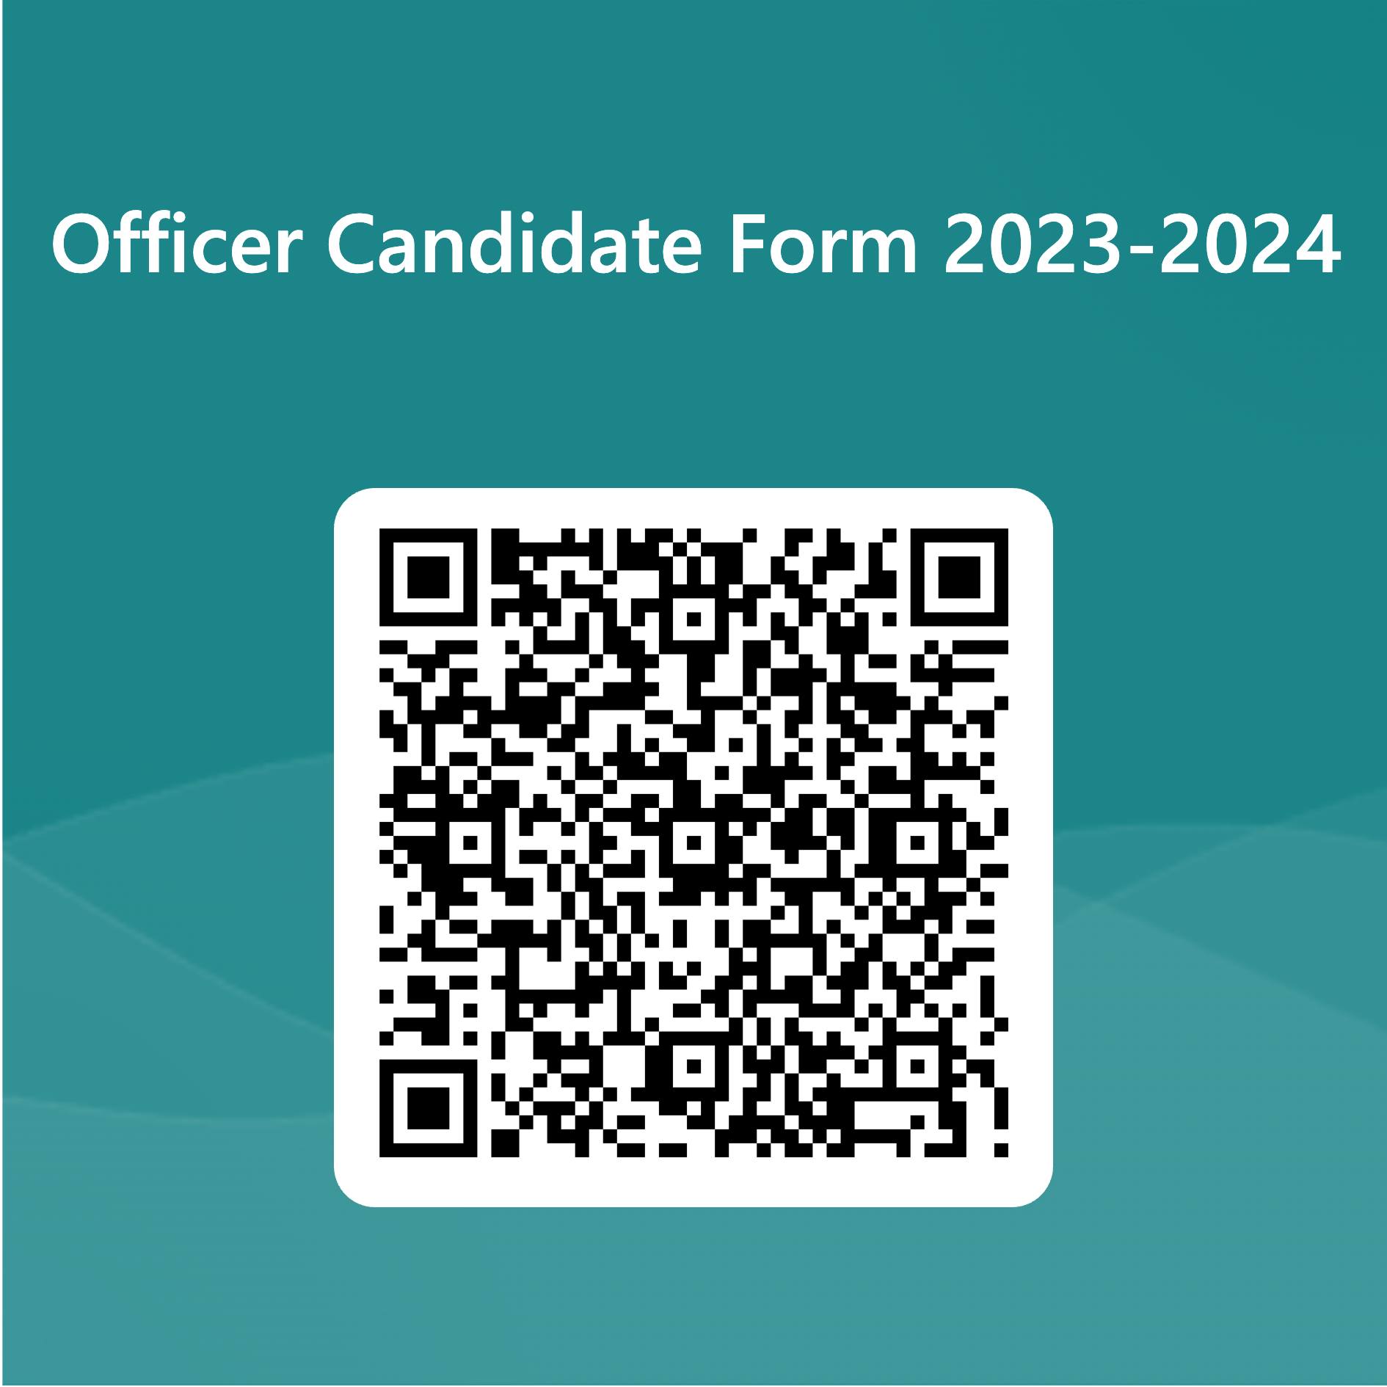
Benefits of being an Officer
What is your favorite part of being an officer?
What are 2 – 3 skills you acquired or developed from being an officer?
How has being an officer helped you career goals?
Notes:
Repeaters in New Mexico
Knowledge of the ITU Phonetic Alphabet
Point to point communication
Government Emergency Telecommunications System
Global Communication
Scholarship Availability
Send Email over the Radio with out the internet
Continuing education units and professional development hours
Amateur Radio Emergency Services (ARES)
Search and Rescue

Slide 5
Registration Info + Social
Speak to officers or other members for advice, tips and general information on registering for classes!

Slide 6
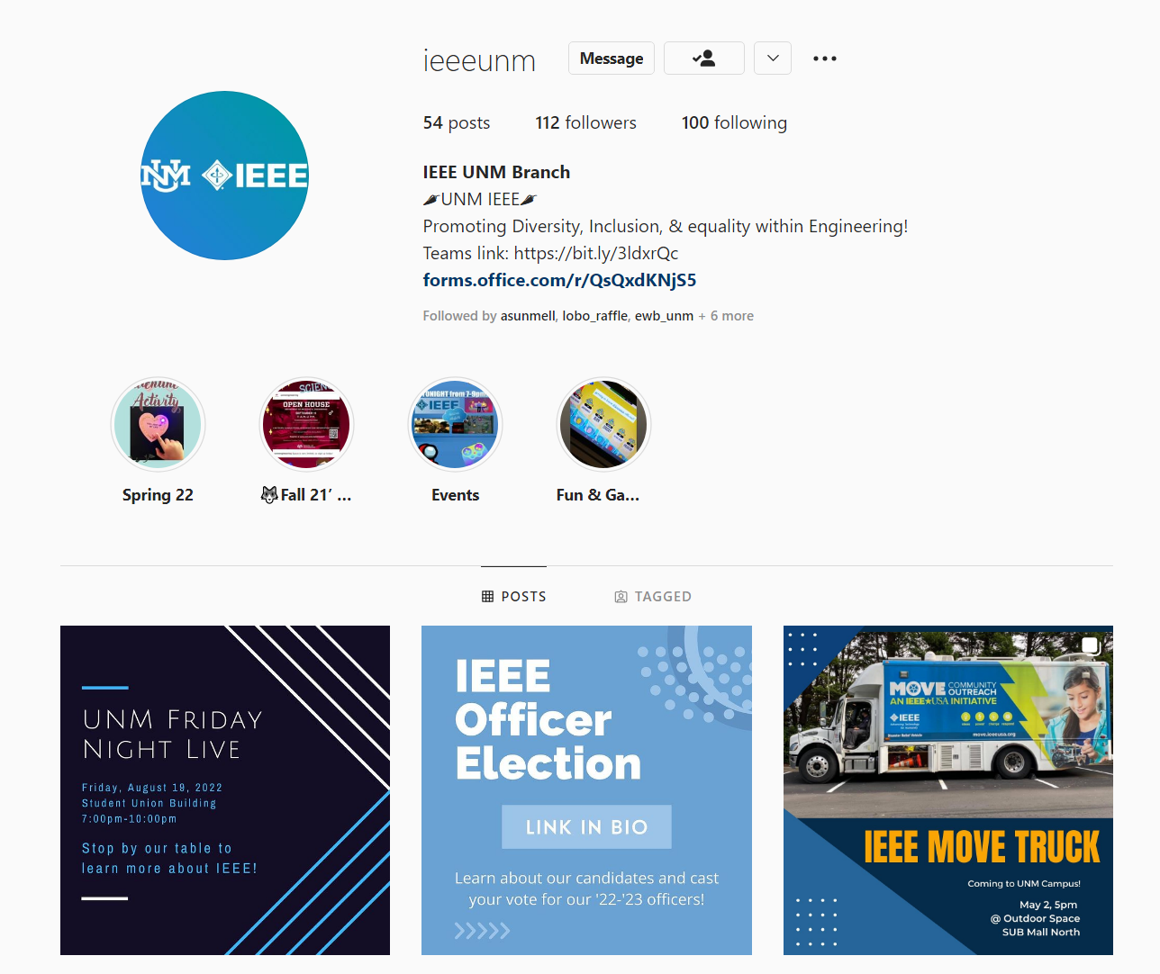
IEEE Information
Scan QR Code for Links
Room: IEEE Lounge (108), 1st Floor ECE Building
Email: ieee@unm.edu
Website: https://ieee.unm.edu/
Discord: https://discord.gg/t7jewH3
Instagram: ieeeunm

Slide 7
Thank You!
IEEE Officers / Assistants / Members
Last Meeting 5/2/2023
ECE 118 6:30 PM

